Slide 1
Monitoring User Resource Utilization
Thunderbolt
Amsal Naeem, Parneet Kaur, Vanthana Sachdev

Slide 2
Group project Description
List of Tasks
  Task 1 : Setting up Cloud environment
  It involves setting up and understanding Devstack architecture, configuring the required services and interacting with devstack services.
  Task 2: Gathering metrics
  Devstack services are used to gather metrics. Mainly used services include heat, ceilometer, nova, neutron, swift, cinder, glance.
  Task 3: Web application
  The front end of the webportal will be a user interface created using HTML, CSS and JavaScript (on the front end). Server will be created Node JS.
  Task 4: Integration
  This involves integrating front end application and the under laying metrics collection on cloud.

Slide 3
Project Description (cont.)
Tasks allocation
Parneet 33.33%
Amsal 33.34%
Vanthana 33.33%
Tasks | Assignee | % of work
Cloud setup | Amsal, Vanthana | 35
Web application setup | Parneet, Amsal | 25
Integrating web application and cloud | Parneet, Amsal, Vanthana | 30
Documentation | Parneet, Amsal, Vanthana | 10

Slide 4
Technical Details
Hardware used
  3 Virtual Machines on Thoth lab Cloud
Software used
  Environment: Devstack
  Application Interface: OpenStack API, RESTful API
  Services: Heat, ceilometer, nova, neutron, swift, cinder, glance
  Tools: Ububtu server
  Programming Language: Python, HTML, CSS, JavaScript, Node Js
  IDEs: Text Editor(Sublime Text)

Slide 5
Technical Details
Project setup (Network topology and requirements)
CLOUD SETUP
WEB PORTAL
Connection(REST API)
User Interface

Slide 6
Technical Details
Roadmaps of your project (Milestones)
Tasks | Start Date | End Date
Cloud Setup | 09/05/16 | 09/22/16
Web App Setup | 09/23/16 | 10/06/16
Connection | 10/07/16 | 10/20/16
Documentation | 21/10/16 | 10/26/16

Slide 7
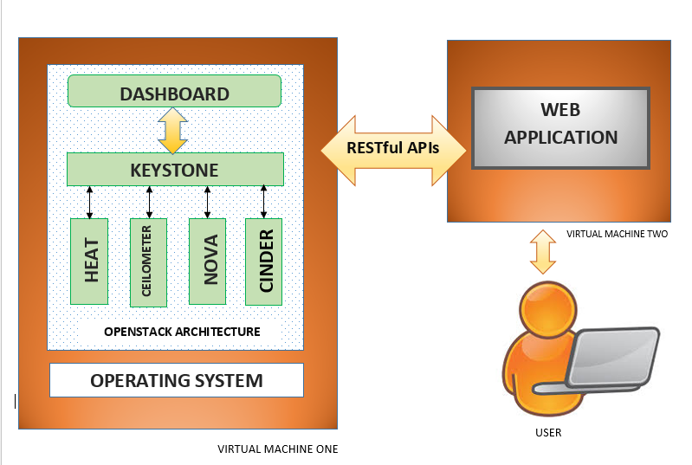
Technical Details

Slide 8
Risks and Benefits
Risks/challenges:
Potential applications and Benefits:
  More Efficient Resource Management.
  Maximized Utilization
  Increase in number of users
Risk Description | Risk | Mitigation Strategy
Network Connectivity | High | Periodically checking n/w connectivity
Machine Overload | High | Use machine with higher configuration
Data Loss | Medium | Implementing a cloud based data backup

Slide 9
Tasks Accomplished by Now
First Phase Documentation
Acquired required resources
Research (ongoing)

Slide 10
Conclusion
The need of the hour is to efficiently and cost effectively utilize limited resources to build and complete tasks in a scalable manner, especially with most companies and institutions offloading their work to Cloud. To address this problem, which is and will in the future gain more notoriety, we are building a Web Application to monitor resource utilization.

